Slide 1
A Special Thank You!
original slides by Senora AnneMarie Chase
you can find the original in Spanish here: https://senorachase.com/2019/09/21/new-year-new-routine/
adapted and edited by Laura Berg

Slide 2
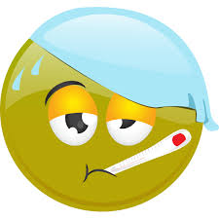



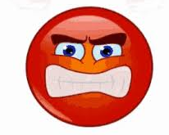




aeger / aegra
tristis
laetus / laeta
confusus /
confusa
iratus / irata
taedio affectus / affecta
optime
¿Quis est? Who is...?
(Ego) sum - I am
anxius /
anxia
fessus / fessa
Notes:
Ut vales? Valeo… bene / optime / male / pessime / mediocriter.
Quomodo te habes? Me habeo bene / male.

Slide 3







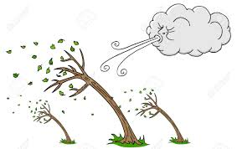
Qualis tempestas est?
pluit
nubila est
ventosa est
calida est
ningit
leviter
lightly
graviter
heavily
tepida
est
sol lucet
frigida est
Notes:
Qualis tempestas sit cras/in Italia?

Slide 4

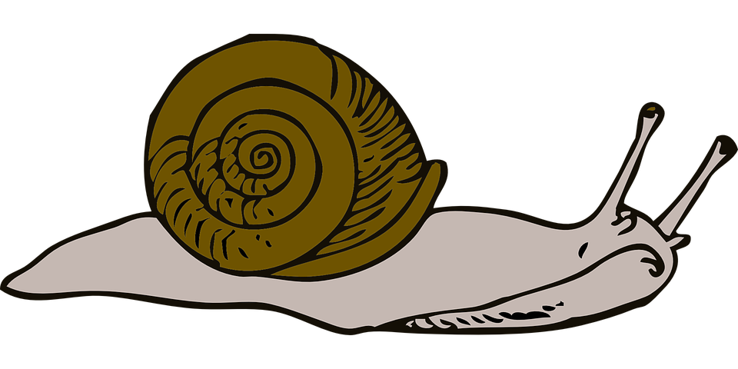

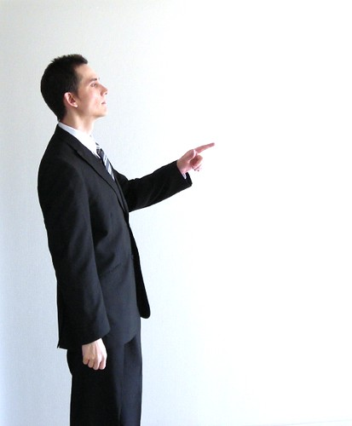






Total Physical Response (TPR)
ad sellam tuam
tarde
huc
illuc
ad ianuam
celere / celeriter
valde
tacite
manum
ad fenestram
Notes:
Practice commands with action verbs. A good review of adverbs is also very possible.

Slide 5


Quid hodie est?
hodie est...
Quis abest? adestne...?
Ubi est?
Where is...?
Potestne fieri?
Is it possible (that)...?
Sitne?
Might s/he be...?
Is... here?
Notes:
Potestne fieri ut (+ subjunctive present tense, imperfect/perfect/pluperfect tenses)…

Slide 6

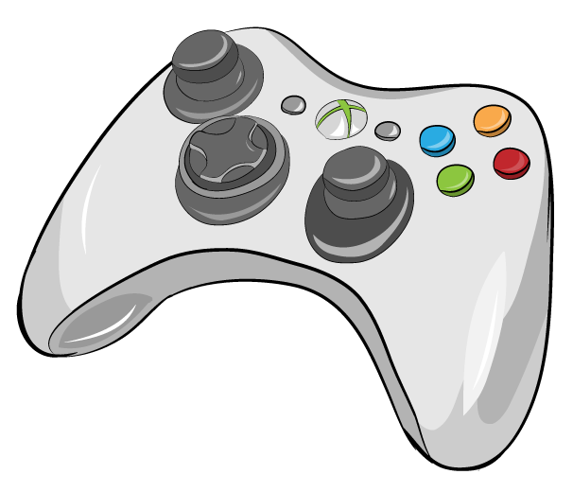

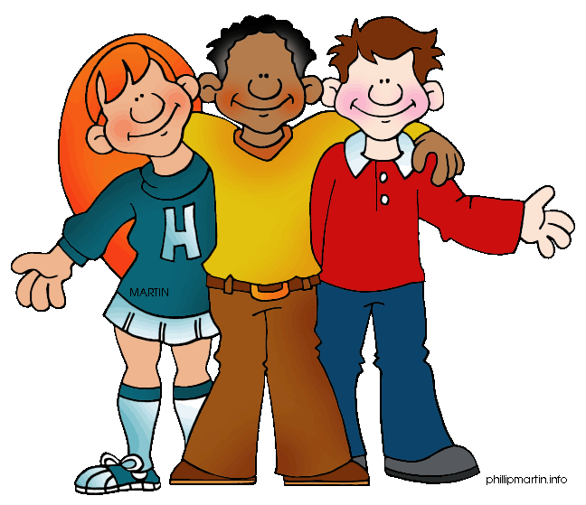

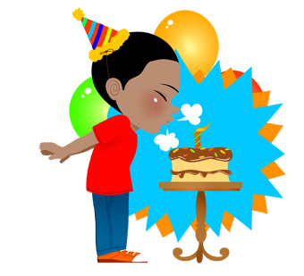
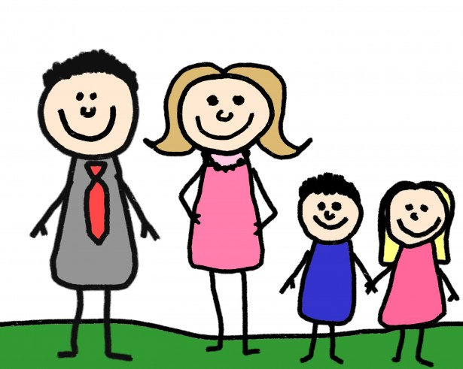
Quid hodie agis?
ludo
I am playing
specto
I am watching
audio
I am listening to
eo
I am going
dormio
I am sleeping
celebro
I am celebrating
mihi necesse est
I need/have (to)
nihil ago
I am doing nothing!
lusum electronici
athleticam
fabulam /
pellicula
cum amicis
musicam
cum
familia
felicem natalem

Slide 7
Quid heri/superiore nocte egisti?
lusi
I played
vidi
I saw
audivi
I listened to
ivi
I went
dormivi
I slept
celebravi
I celebrated
mihi necesse erat
I had (to)
nihil egi
I did nothing!
lusum electronici
athleticam
fabulam /
pellicula
cum amicis
musicam
cum
familia
felicem natalem

Slide 8
Quid cras ages?
ludam
I will play
videbo
I will see
audiam
I will listen to
ibo
I will go
dormiam
I will sleep
celebrabo
I will celebrate
mihi necesse erit
I will have (to)
nihil agam
I will do nothing!
lusum electronici
athleticam
fabulam /
pellicula
cum amicis
musicam
cum
familia
felicem natalem

Slide 9

Quid est in sacco?
in the bag?
libellus stilus charta
pensum liber cibus
phonulum lagena arcanum
notebook pencil/pen paper
work book food
phone drink mystery
Notes:
Ask a student ahead of time, if you might use their bag to go through.
Make it a guessing game. 2. Use adjectives to describe items. 3. Ask students what items are used for.
Review colors, sizes, etc. Can also ask students: Quis ______ in sacco habet?
Describe items in a bag (borrowed) and have students guess at which item you are describing.

Slide 10
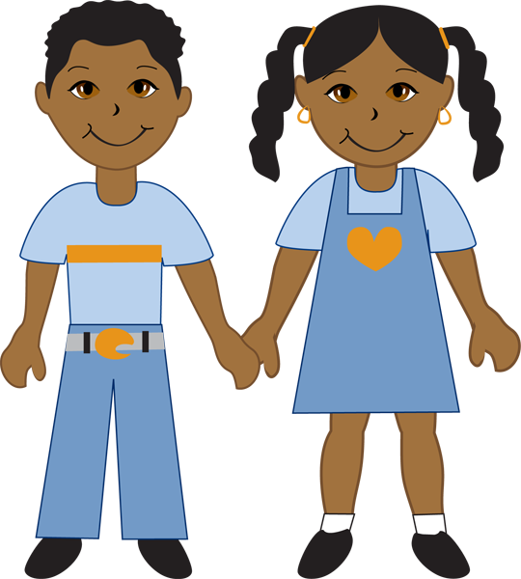



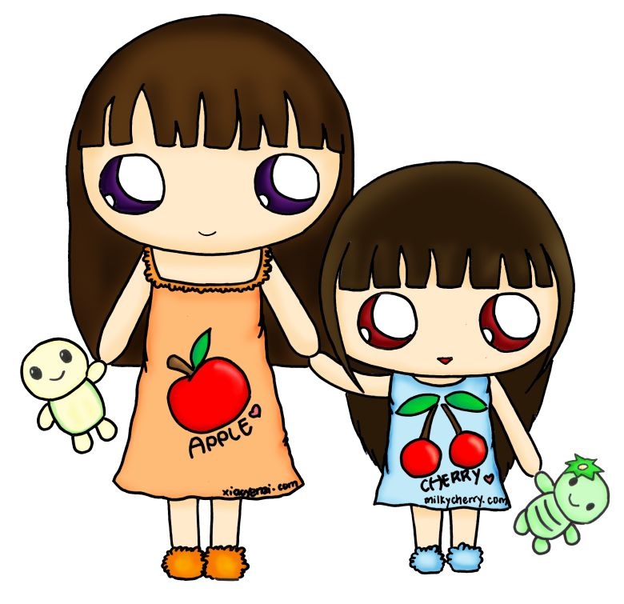
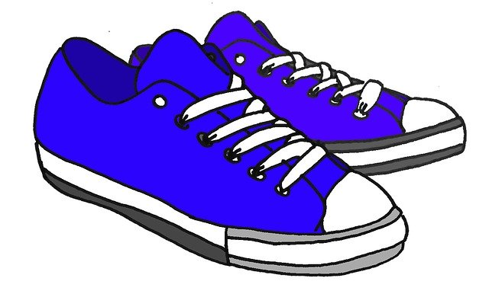
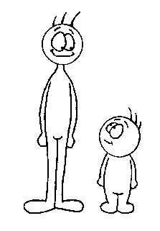

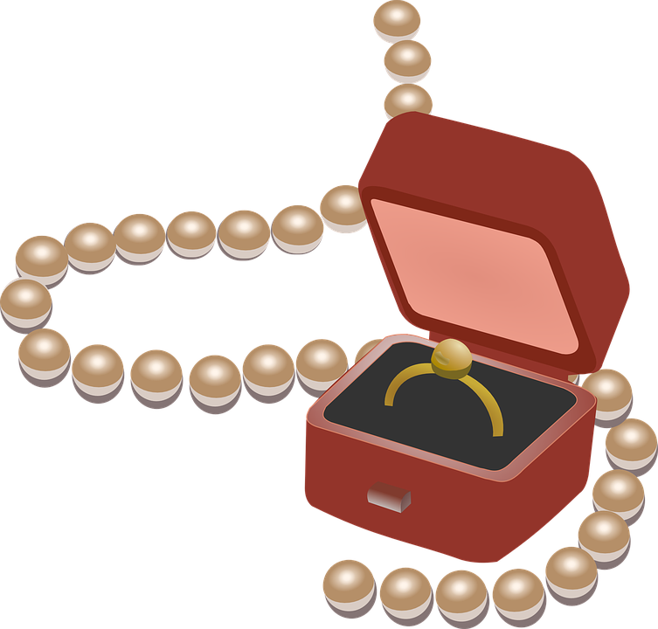
Guess Who
ita vero / minime
(nomen) eligo. estne (nomen)?
estne puer?
estne capillus (color)?
estne puella?
suntne oculi (colores)?
geritne (colorem)?
estne in annos maiores aut minores?
geritne calceos (colores)?
habetne perspicillum?
estne longus/a aut brevis?
habetne gemmas?
Notes:
One student leaves the room, the class votes a person to be “it”. The student who returns then asks yes/no questions to guess the person who is it. The teacher answers the questions, while those in class who don’t apply sit down. No more than 4-5 questions should be asked, then the student has to choose.

Slide 11

Duo vera et unum mendacium
Two truths and one lie
est mendacium. est verum.
scio! nescio.
mendax! nugae! insanus!
that’s a lie. that’s the truth.
I know! I don’t know.
liar! nonsense! crazy!
Notes:
Make up two true things/one false thing about yourself, your weekend, your day, students, and/or events in the world.
Students listen, then quietly debate which is truth and which is a lie.

Slide 12
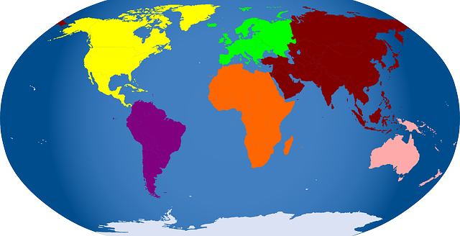
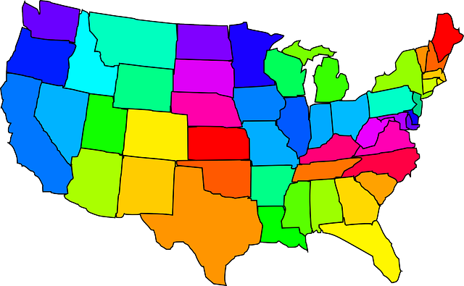

Ubi est in mundo?
in the world
audite et putate!
and think!
in civitate
Virginia est civitas.
in continente
Africa est continens.
in patria
U.S.A. est patria.
in urbe
Nashville est urbs.
Notes:
Gather an interesting article from the recent news. Retell the article in simple language. Students guess where the news article happened.

Slide 13


Quid est clavis?
What is the password?
Haec hebdomas, clavis in classem est:
this week
Tota nocte vigilavi!
Notes:
First day: Practice password until students are comfortable saying it.
Second day: Discuss when it would be used in context.
Third day: Introduce either question or response (from teacher to solicit or respond to saying).
Fourth day: Grammar discussion.
Fifth day: Grammar discussion.

Slide 14






scribimus
Magistra docet...
discipuli discunt
legimus
Hodie in classe...
dicimus / audimus
spectamus
cantamus
dico et auditis
pingimus
Notes:
Primo – at first; tum/tunc – then; tandem – finally

Slide 15
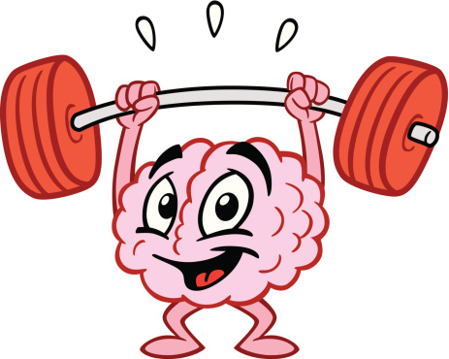
Brain Breaks in Latin

Slide 16
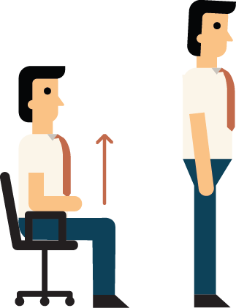

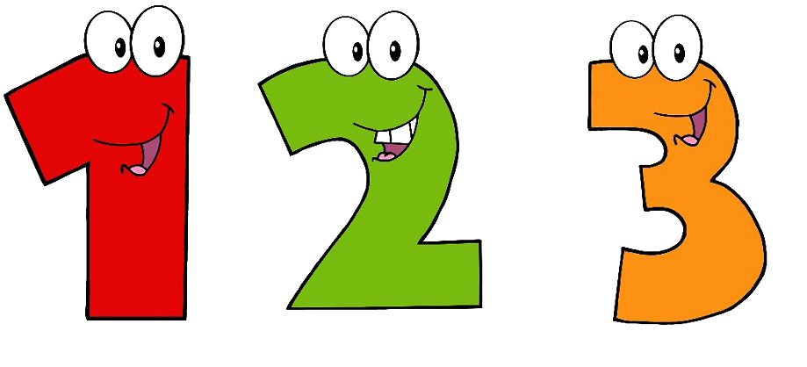

Decimation
Discipuli, state!
Formate circulum!
Magistra incipiet... unus, duo, tres.
Discipuli, dicite unum numerum, duos numeros, aut tres numeros.
Si dicis “decem”, sede in sella tua.
Notes:
Students stand in a circle. Teacher starts counting in Latin. Students continue counting around the circle. Students may say one number, two numbers, or three numbers; students cannot say more than three consecutive numbers. Students must say consecutive numbers 1-10. Any student that says 10 is out and must sit down.

Slide 17




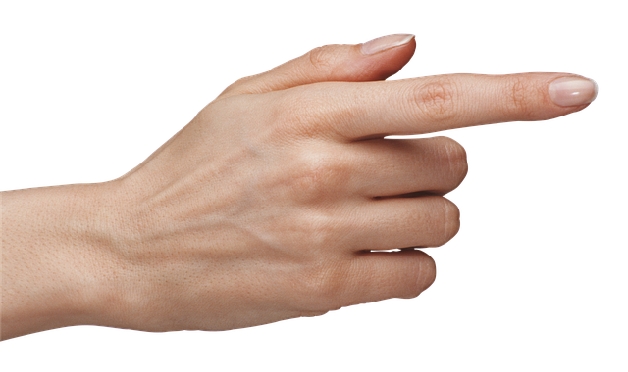

Heads Down, Thumbs Up!
Magistra legit tres personas.
Discipuli, descendite capita in mensa!
Discipuli, ascendite pollicem.
Discipuli, claudite oculos!
Tres personae lectae, “Ite per classem. Legite discipulos tactis pollicibus!”
Discipuli, ascendite capita.
Discipuli tacti, state! Quis te tetigit?

Slide 18
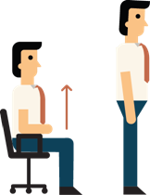

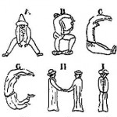
Spelling
Discipuli, state!
Discipuli, formate turbam.
Magistra dicet verbum in Latine...
formate litteras verbi in Anglice.
AUT, Magistra dicet verbum in Anglice...
formate litteras verbi in Latine.
Notes:
Students work in groups and use their bodies to spell out the meanings of vocabulary words. Can work both ways: give English, spell Latin or give Latin and spell English.

Slide 19

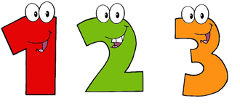

Amici aut Inimici
Discipuli, state!
Discipuli, movete erratice!
Magistra dicet numerum.
Formate turbam discipulorum istius numeri.
Si magistra dicit “quattuor”
tum invenit
quattuor discipulos
et una stant.
Notes:
Students move randomly around the classroom. The teacher calls out a number in Latin. Students must rush to form a group of students with the number said. Students left out of a group, are out.

Slide 20


Tangite
Discipuli, state!
Magistra dicet colorem...
“Tangite res alba (aut alium colorem).”
Discipuli, tangite res alba.
Discipulus ultimus tangens res alba, sede ad sellam tuam.
Discipuli in sellis, magistrate auxilium date.
help the teacher
Notes:
Best done in Latin, preferably after teaching students the names of the colors. To students, “Tangite res rubra.” Students race each
other to touch something red in the classroom. The last student to find and touch something red is out. Out students can help the teacher referee the rest of the class. Change up colors each time.

Slide 21
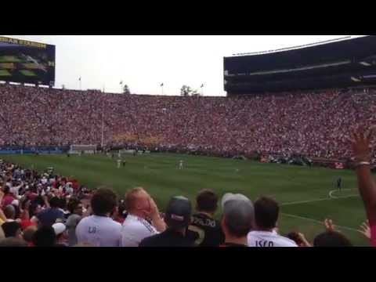
Hortemur
Magistra dicet numeros... “unus, duo, tres”
In numero “tres”: discipuli, state!
  Formate unda stando.
Discipuli, clamate
“io!”
Notes:
My students love this one! Just like in a stadium. Students stand up one at a time, with their hands in the air, to create a wave-like motion around the classroom. Sometimes, we add in sound effects.

Slide 22


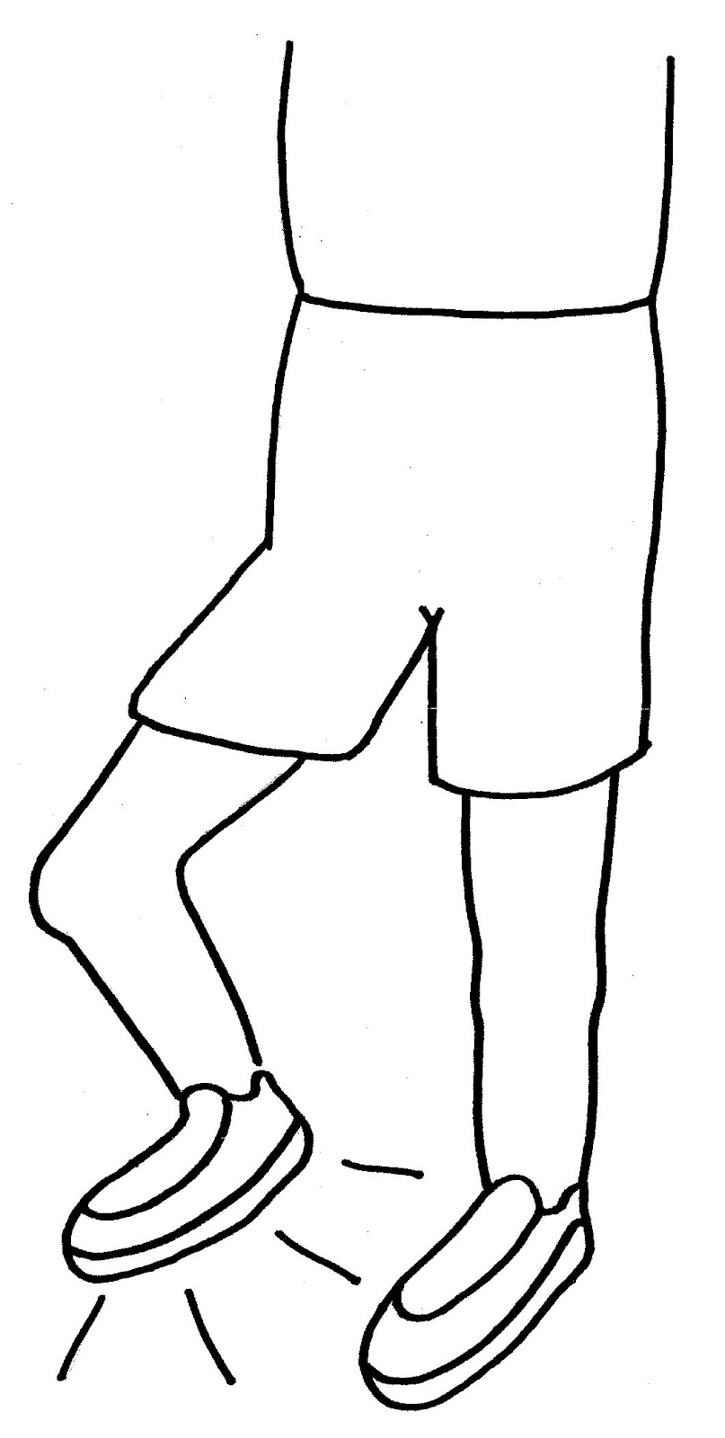
Salite!
Discipuli, state!
Pone stilum tuum in pavimento.
Discipuli, audite et sequimini: transilite pensum!
  duis
  ter
4x
2x
quadrifarius
decemplex
alterutris pedibus
with both feet
3x
10x
pede
dextro →
pede
sinistro
Notes:
Students jump back and forth over the pencil on the floor as instructed by the teacher.

