Slide 1
A Special Thank You!
original slides by Senora AnneMarie Chase
you can find the original in Spanish here: https://senorachase.com/2019/09/21/new-year-new-routine/
adapted and edited by Laura Berg

Slide 2
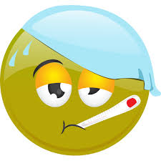



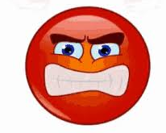




aeger / aegra
tristis
laetus / laeta
confusus /
confusa
iratus / irata
taedio affectus / affecta
optime
¿Quis est? Who is...?
(Ego) sum - I am
anxius /
anxia
fessus / fessa
Notes:
Ut vales? Valeo… bene / optime / male / pessime / mediocriter.
Quomodo te habes? Me habeo bene / male.

Slide 3







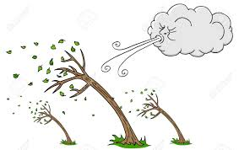
Qualis tempestas est?
pluit
nubila est
ventosa est
calida est
ningit
leviter
lightly
graviter
heavily
tepida
est
sol lucet
frigida est
Notes:
Qualis tempestas sit cras/in Italia?

Slide 4

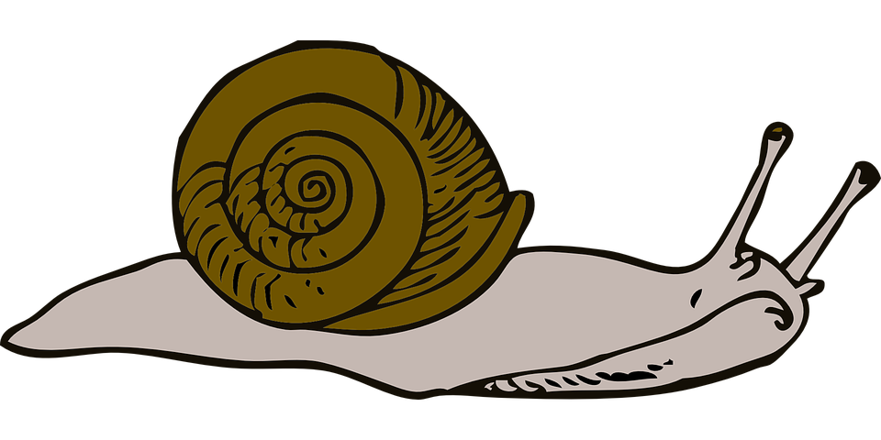

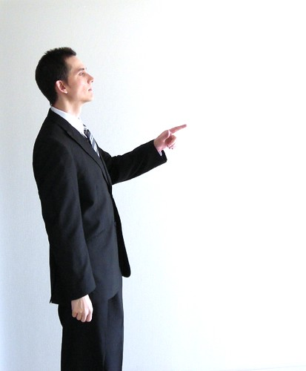






Total Physical Response (TPR)
ad sellam tuam
tarde
huc
illuc
ad ianuam
celere / celeriter
valde
tacite
manum
ad fenestram
Notes:
Practice commands with action verbs. A good review of adverbs is also very possible.

Slide 5


Quid hodie est?
hodie est...
Quis abest? adestne...?
Ubi est?
Where is...?
Potestne fieri?
Is it possible (that)...?
Sitne?
Might s/he be...?
Is... here?
Notes:
Potestne fieri ut (+ subjunctive present tense, imperfect/perfect/pluperfect tenses)…

Slide 6



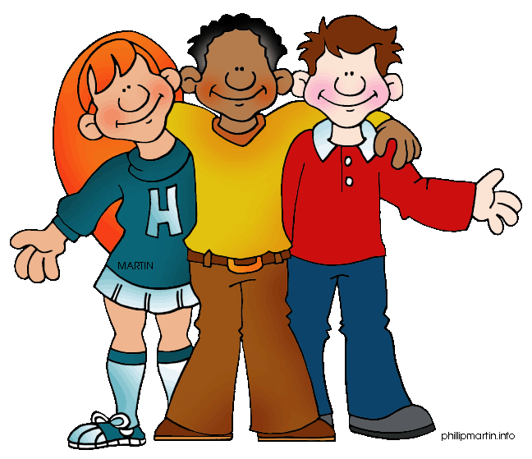

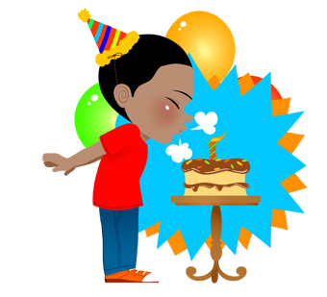
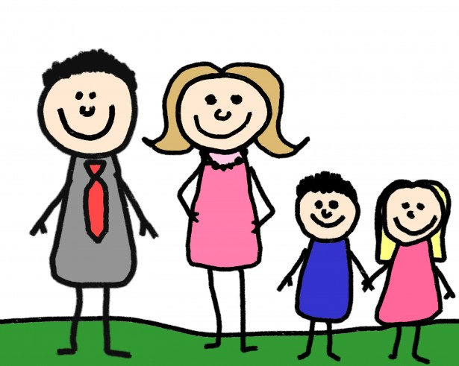
Quid hodie agis?
ludo
I am playing
specto
I am watching
audio
I am listening to
eo
I am going
dormio
I am sleeping
celebro
I am celebrating
mihi necesse est
I need/have (to)
nihil ago
I am doing nothing!
lusum electronici
athleticam
fabulam
pellicula
cum amicis
musicam
cum
familia
felicem natalem

Slide 7
Quid heri/superiore nocte egisti?
lusi
I played
vidi
I saw
audivi
I listened to
ivi
I went
dormivi
I slept
celebravi
I celebrated
mihi necesse erat
I had (to)
nihil egi
I did nothing!
lusum electronici
athleticam
fabulam
pellicula
cum amicis
musicam
cum
familia
felicem natalem

Slide 8
Quid cras ages?
ludam
I will play
videbo
I will see
audiam
I will listen to
ibo
I will go
dormiam
I will sleep
celebrabo
I will celebrate
mihi necesse erit
I will have (to)
nihil agam
I will do nothing!
lusum electronici
athleticam
fabulam
pellicula
cum amicis
musicam
cum
familia
felicem natalem

Slide 9

Quid est in sacco?
in the bag?
libellus stilus charta
pensum liber cibus
phonulum lagena arcanum
notebook pencil/pen paper
work book food
phone drink mystery
Notes:
Ask a student ahead of time, if you might use their bag to go through.
Make it a guessing game. 2. Use adjectives to describe items. 3. Ask students what items are used for.
Review colors, sizes, etc. Can also ask students: Quis ______ in sacco habet?

Slide 10

Duo vera et unum mendacium:
Two truths and one lie:
est mendacium. est verum.
scio! nescio.
mendax! nugae! insanus!
that’s a lie. that’s the truth.
I know! I don’t know.
liar! nonsense! crazy!
Notes:
Make up two true things/one false thing about yourself, your weekend, your day, students, and/or events in the world.
Students listen, then quietly debate which is truth and which is a lie.

Slide 11
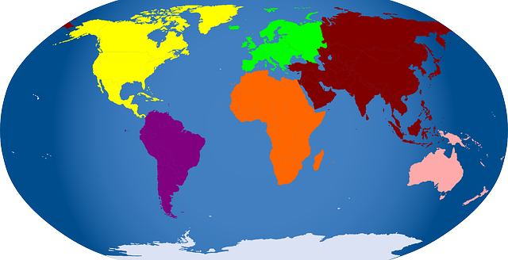
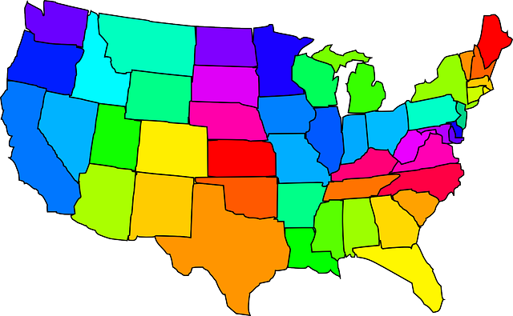

Ubi est in mundo?
in the world
audite et putate!
and think!
in civitate
Virginia est civitas.
in continente
Africa est continens.
in patria
U.S.A. est patria.
in urbe
Nashville est urbs.
Notes:
Gather an interesting article from the recent news. Retell the article in simple language. Students guess where the news article happened.

Slide 12


Quid est clavis?
What is the password?
Haec hebdomas, clavis in classem est:
this week
Te desideravi tantum!
Notes:
First day: Practice password until students are comfortable saying it.
Second day: Discuss when it would be used in context.
Third day: Introduce either question or response (from teacher to solicit or respond to saying).
Fourth day: Grammar discussion.
Fifth day: Grammar discussion.

Slide 13






scribimus
Magistra docet...
discipuli discunt
legimus
Hodie in classe...
dicimus / audimus
spectamus
cantamus
dico et auditis
pingimus
Notes:
Primo – at first; tum/tunc – then; tandem – finally

